Slide 1
School of Geography and Geology
McMaster University
Advanced Topics in Spatial Statistics
Session 11
Spatially Continuous Data II

Slide 2
This session
Trend surface analysis (cont’d)
  Matrix notation
  Example: Walker Lake
Studying spatial structure
  Covariogram and variogram
  Empirical variogram
  Variogram models
  Fitting variogram models

Slide 3
Trend Surface Analysis
A method to model the first order component of a spatial process
Multiple regression analysis using the coordinates of the points as explanatory variables

Slide 4
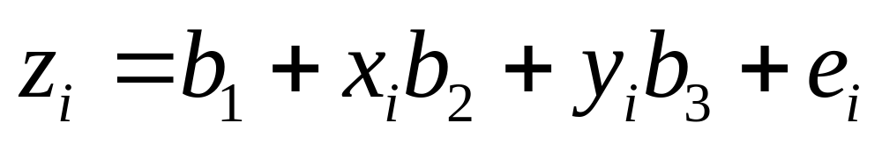
Trend Surface Analysis
Linear trend surface
  z: objective variable
  b₁ , b₂ , b₃: regression parameters
  x , y: coordinates of point i

Slide 5
Trend Surface Analysis:
Linear Trend
Y
b₂
X₂
b₁
a
X₁

Slide 6
Trend Surface Analysis
Quadratic trend surface
  z: objective variable
  b₁ , b₂ ,…, b₆ : regression parameters
  x , y: coordinates of point i

Slide 7
Trend Surface Analysis
Higher order polynomials
  Cubic
  Quartic
  …

Slide 8
Trend Surface Analysis
Potential issues
  Multicolinearity
  Trend surfaces tend to “curl” around the edges
Wolfcamp Aquifer example: fairly good fit

Slide 9
Regression Analysis: Matrix Notation
Linear trend surface

Slide 10
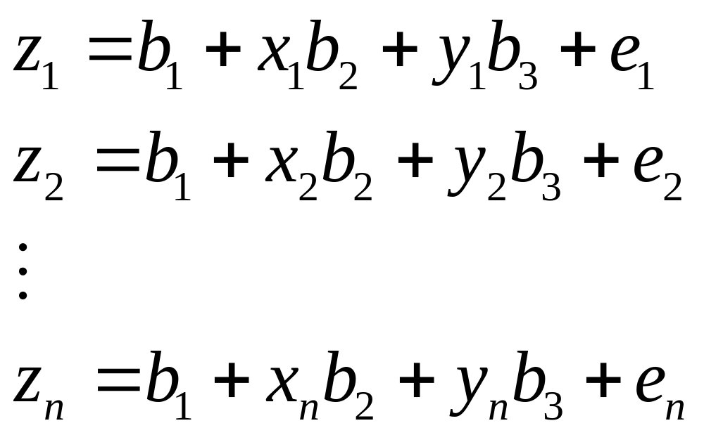
Regression Analysis: Matrix Notation
Linear trend surface

Slide 11
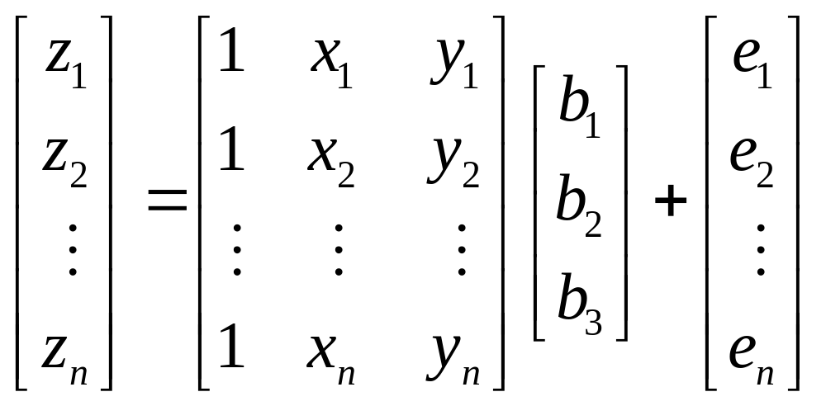
Regression Analysis: Matrix Notation
Linear trend surface

Slide 12
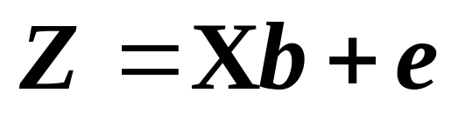
Regression Analysis: Matrix Notation
Linear trend surface

Slide 13
Regression Analysis: Assumptions
Error terms

Slide 14
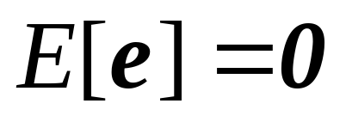
Regression Analysis: Assumptions
Error terms
  Expected (mean) value = 0

Slide 15
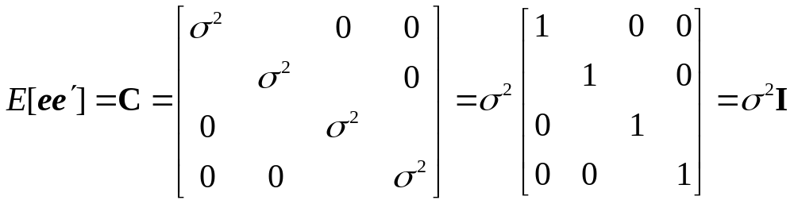
Regression Analysis: Assumptions
Error terms
  Constant variance
  Independent

Slide 16
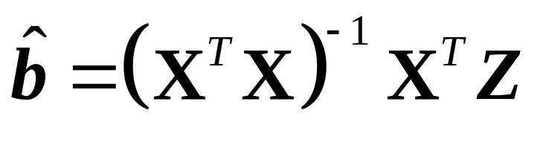
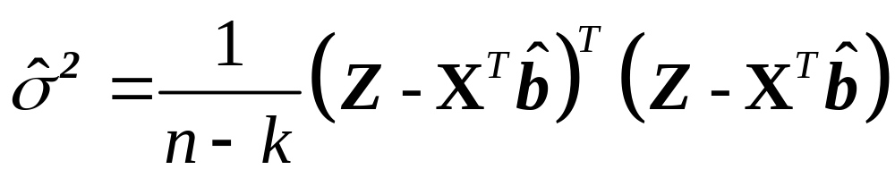
Regression Analysis: Estimation
Parameters
Variance

Slide 17
Example
Walker Lake (Nevada)
  Concentration of pollution
  Soil remediation
Data
  470 observations (pollution ppm)
Geostatistical problem
  Produce indicator maps showing the areas where pollution concentrations exceed a given threshold

Slide 18
Example: Walker Lake
Spatial distribution of observations

Slide 19
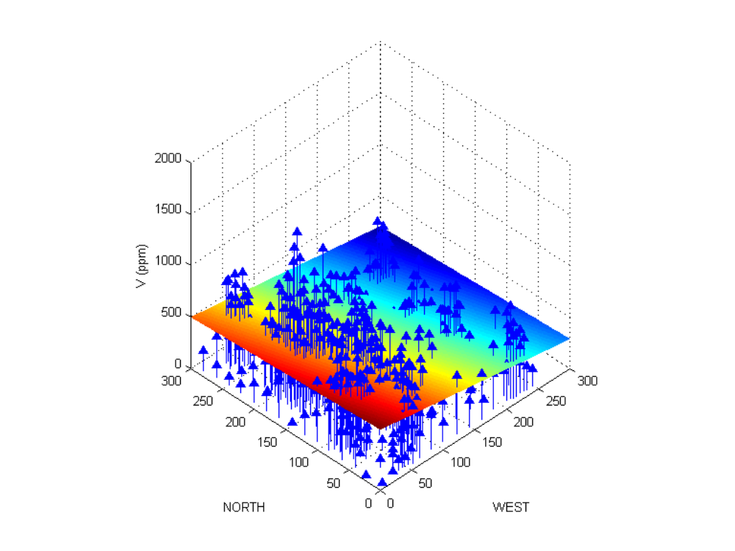
Trend Surface Analysis
Linear trend surface

Slide 20
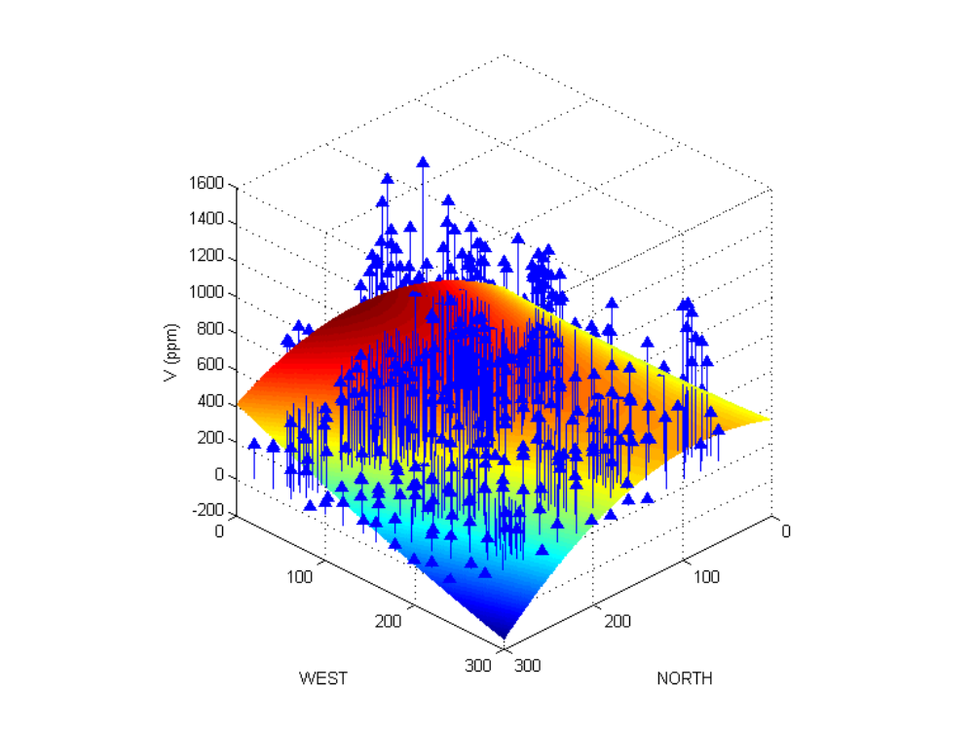
Trend Surface Analysis
Quadratic trend surface

Slide 21
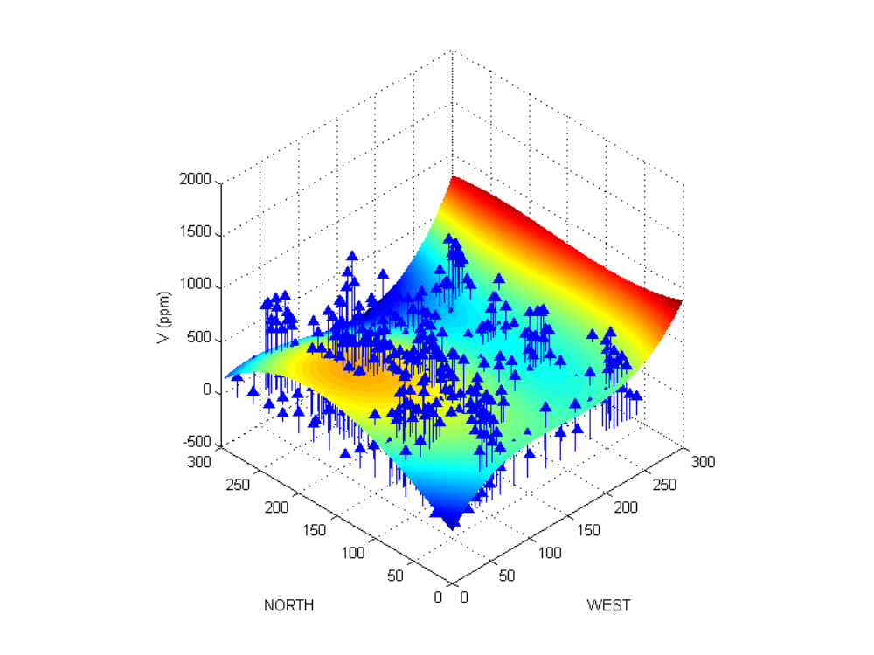
Trend Surface Analysis
Cubic trend surface

Slide 22
Trend Surface Analysis
In addition to multicollinearity and curly surfaces
Spatial structure is missing
  Covariance matrix will not be diagonal!

Slide 23
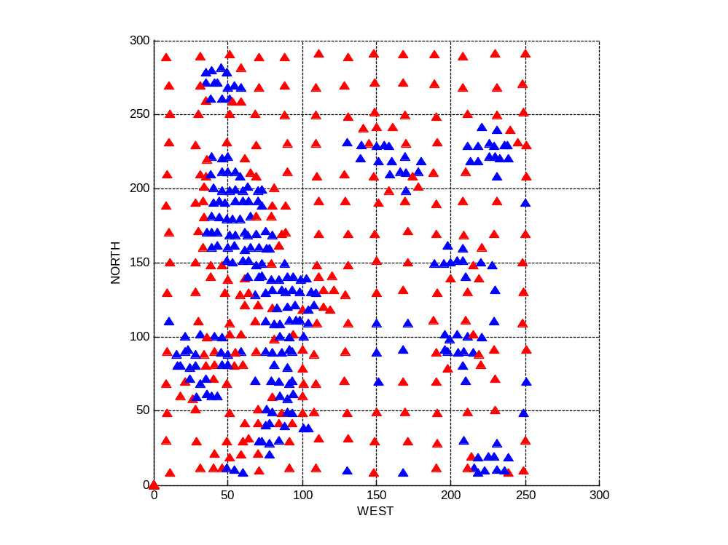
Trend Surface Analysis
Distribution of error terms, linear trend (blue positive-red negative)

Slide 24
Describing Spatial Structure
Q: How can we describe spatial structure?
  Covariogram
  Variogram
  Correlogram

Slide 25
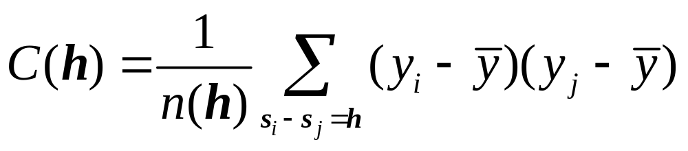
Covariogram
A plot of the covariance of the process at various spatial lags

Slide 26
Covariogram
C(0)=σ²
h

Slide 27
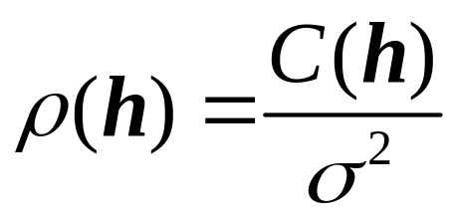
Correlogram
ρ(0)=1
h

Slide 28
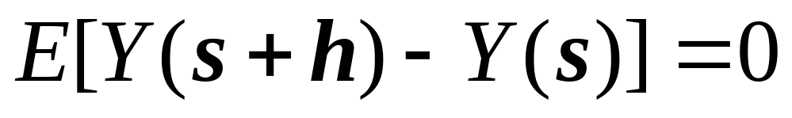
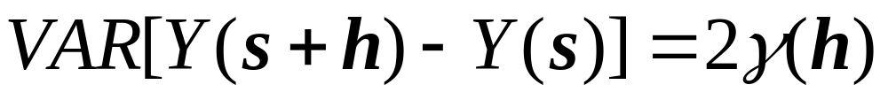
Variogram
Intrinsic stationarity (weaker assumption)

Slide 29
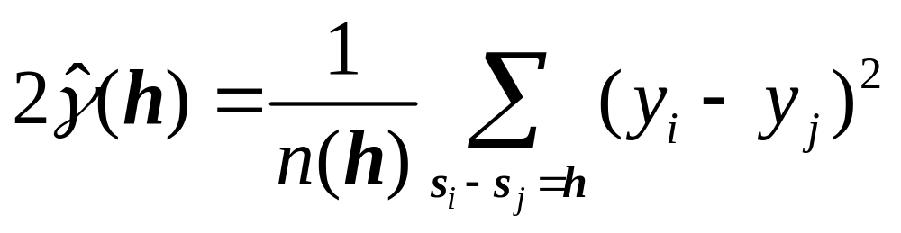
Variogram
Intrinsic stationarity

Slide 30

Variogram
σ²
Sill
Range
h

Slide 31
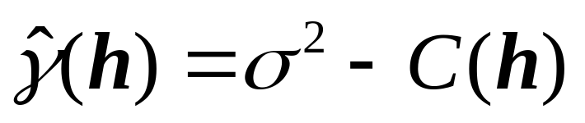
Covariogram, correlogram, variogram
Covariogram C(h)
Correlogram
C(0)=σ²
ρ(0)=1
h
h
Variogram
σ²
h

Slide 32
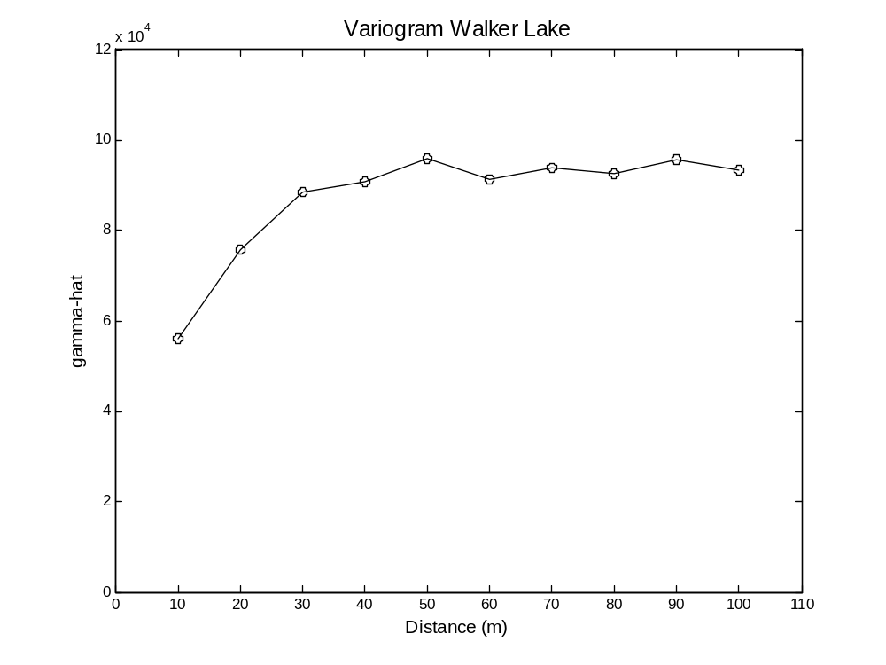
Describing Spatial Structure
Empirical Variogram

Slide 33
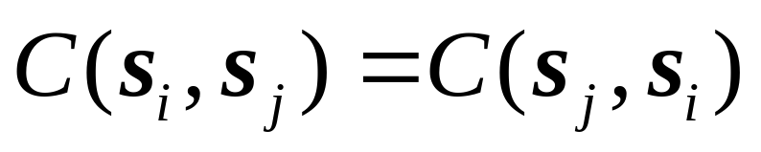
Variogram Models
A theoretical model that fits the empirical variogram
The variogram model should produce a covariance matrix that is:
  Symmetric
  Non-negative definite

Slide 34
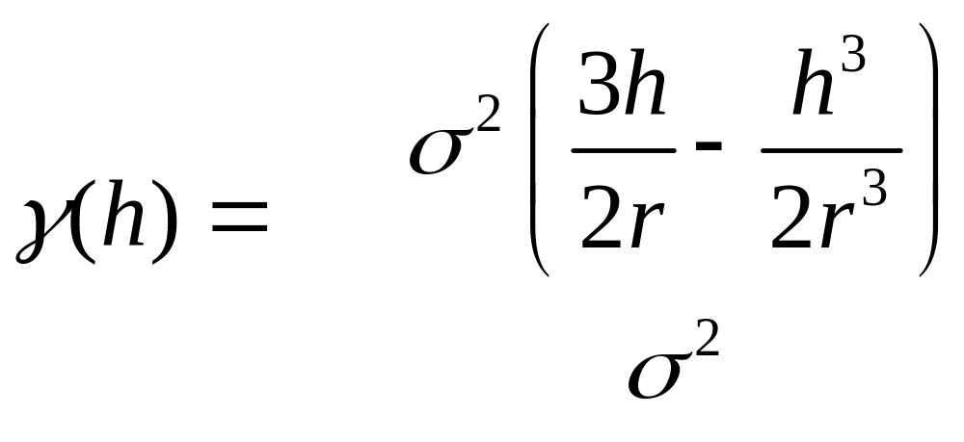
Variogram Models
Spherical
for h ≤ r
otherwise

Slide 35
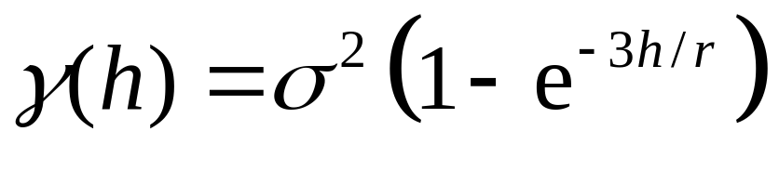
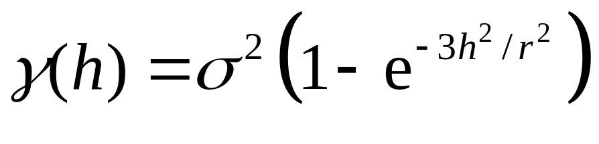
Variogram Models
Exponential
Gaussian

Slide 36
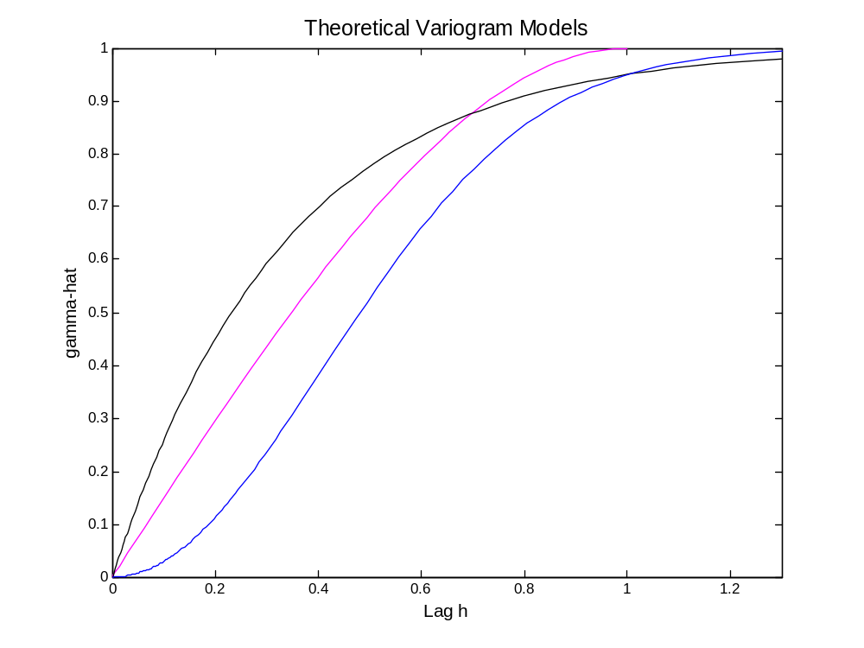
Variogram Models
Exponential
Spherical
Gaussian

Slide 37
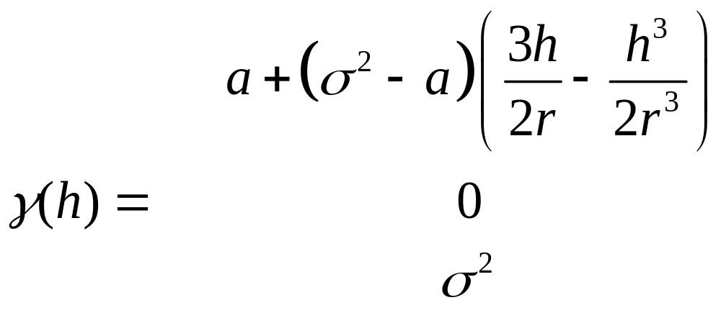
Variogram Models
Spherical with nugget effect
for 0 < h ≤ r
for h = 0
otherwise

Slide 38
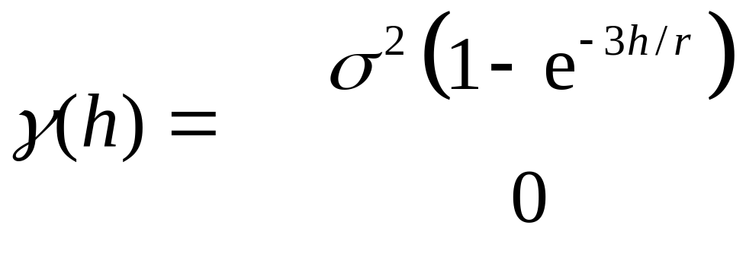
Variogram Models
Exponential with nugget effect
for h > 0
for h = 0

Slide 39
Variogram Models
Fitting variogram models
  Non-linear least squares

Slide 40
Variogram Models
Relative nugget effect
  The ratio of the nugget effect to the sill
  A relative nugget effect of 100% indicates complete lack of spatial dependence

Slide 41
Next…
Spatially continuous data III
  Spatial interpolation
  Kriging

